Slide 1
Optimizing Amazon’s E-commerce Recommendations: Impact of Grouped Displays
Team 2
Yue Sun, Kaia Hu, Jiuyuan Xie

Slide 2
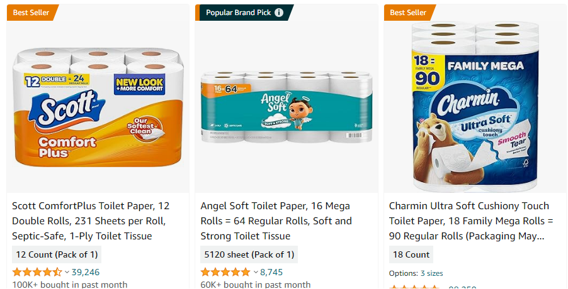
Background
Amazon recommends certain items with product labels.
Best Seller
Top Pick
Amazon Pick
Overall Pick
Those recommended products are arranged randomly and scattered throughout the results shown.
This arrangement design can be confusing and time consuming when users browse through the search results.

Slide 3
Research Question
Does grouping and prioritizing the picked items together at the top of the search results more likely to lead higher selection rates of the recommended products?

Slide 4
Hypothesis
Grouping and prioritizing labeled products at the top of search results will lead to higher selection rates of recommended products, compared to a control group exposed to the standard, scattered arrangement of labeled products in search results.

Slide 5
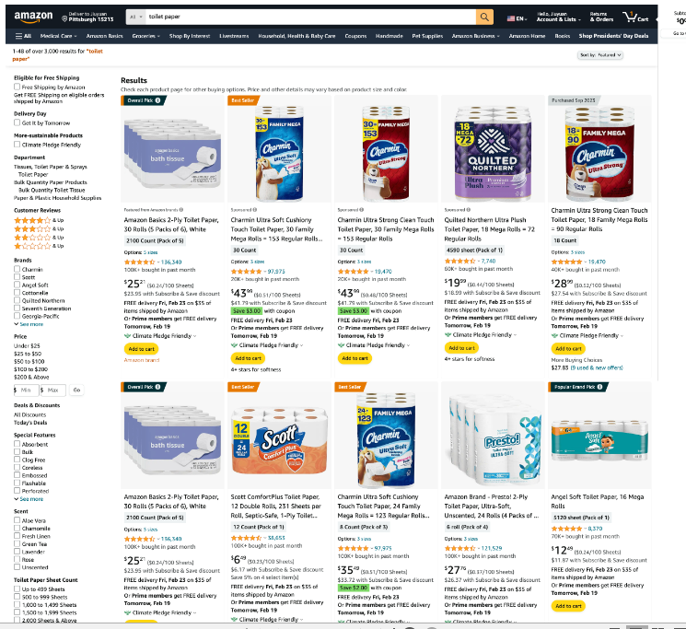
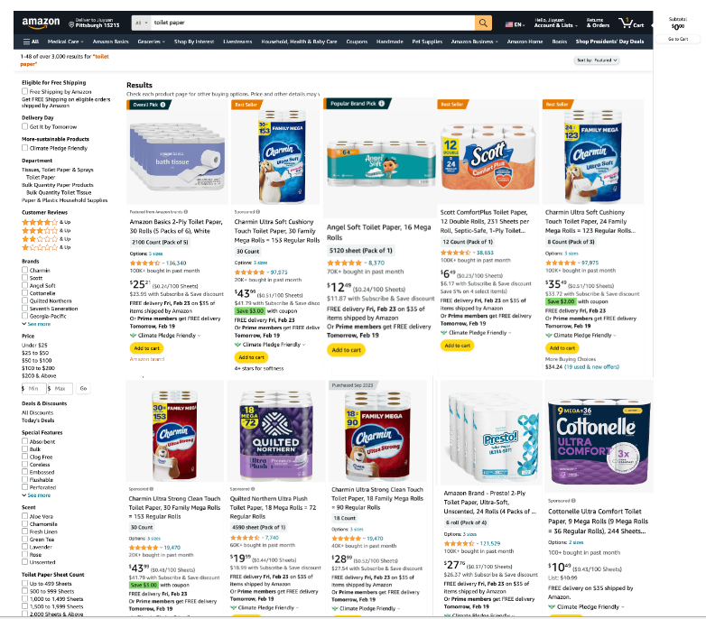
Treatment Implementation - Survey Design
Displayed Product Page in Control Group
Displayed Product Page in Treatment Group

Slide 6
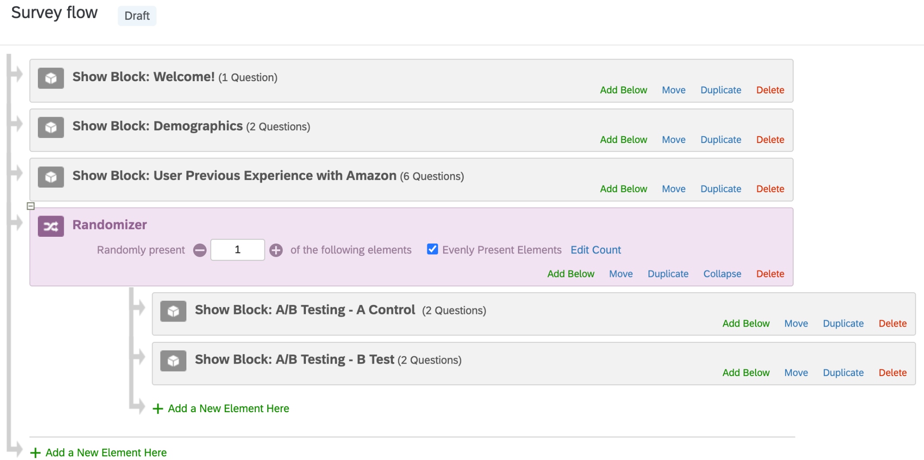
Treatment Implementation - Randomization

Slide 7
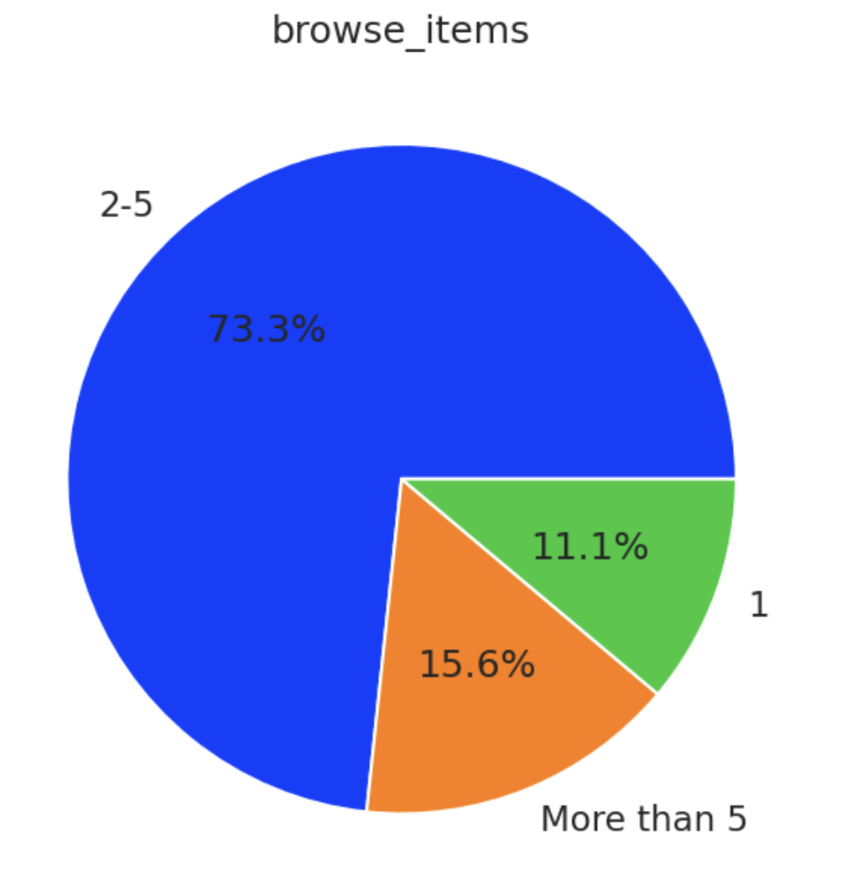
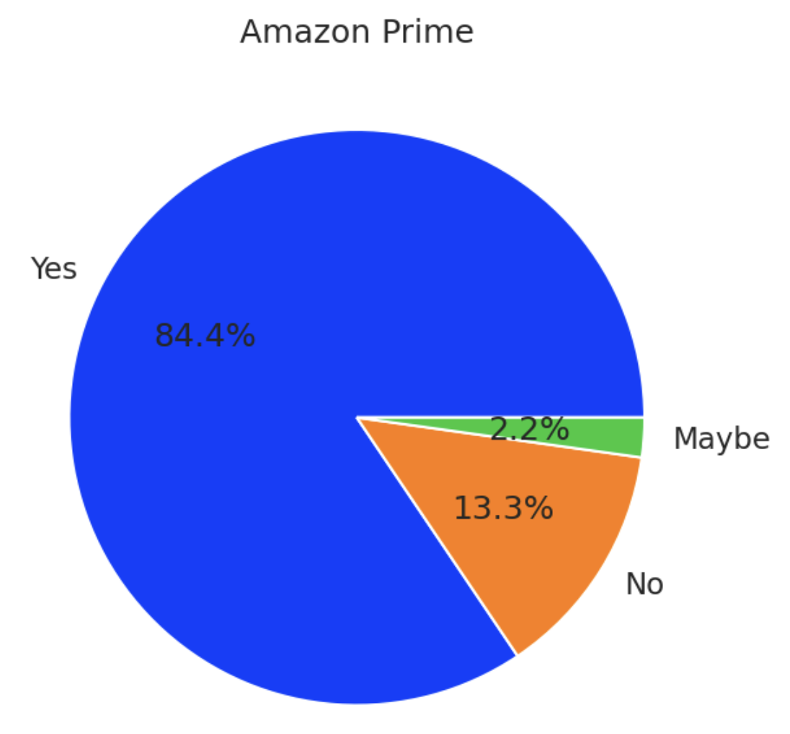
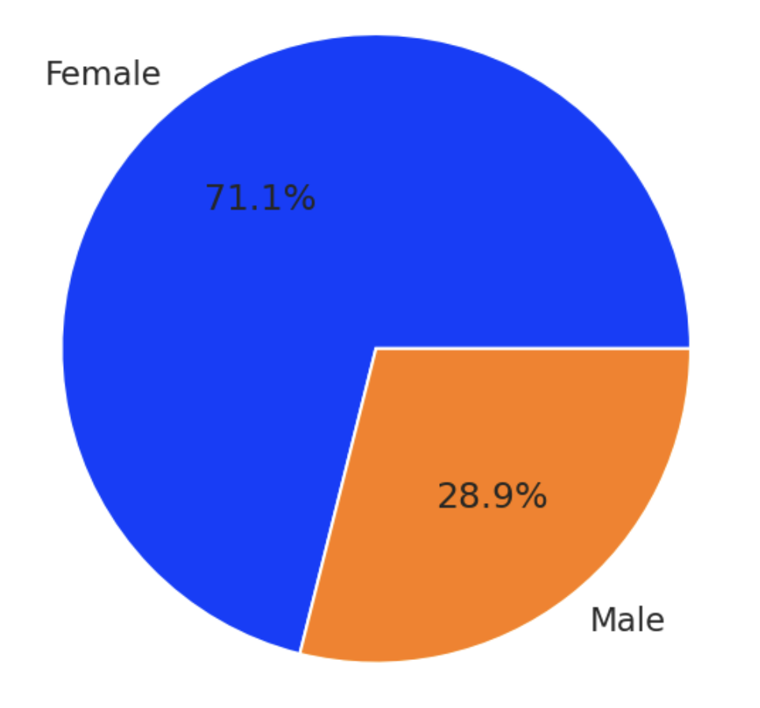
EDA - Demographics & User Experience on Amazon
Gender
User Browsing Habit
Amazon Prime Usage

Slide 8
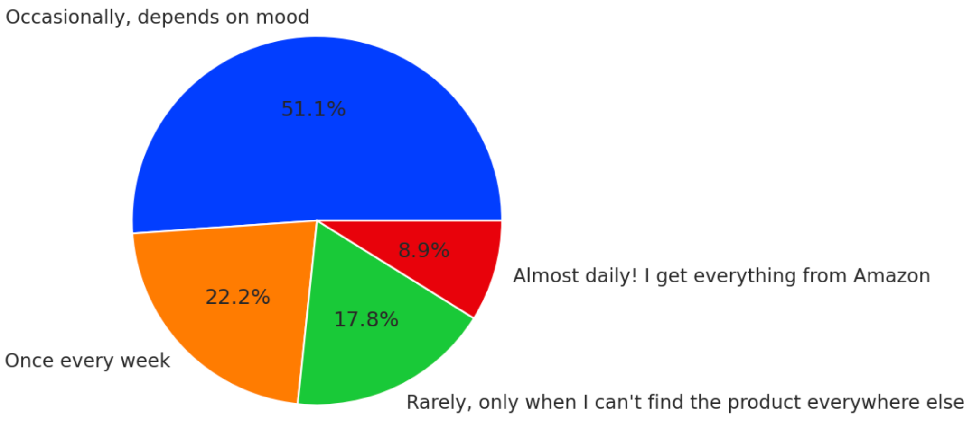
EDA - Demographics & User Experience on Amazon
User Shopping Habit

Slide 9
Results - T tests
Treatment Effect
T Stats
P Values
0.2035
1.3827
0.1738
We ran a most basic T test on the results, without any feature engineering, to understand our data. The P value is bigger than the significance level of 0.05, which indicates that we should not reject the null. However, we decided to run more models to look into it further.

Slide 10
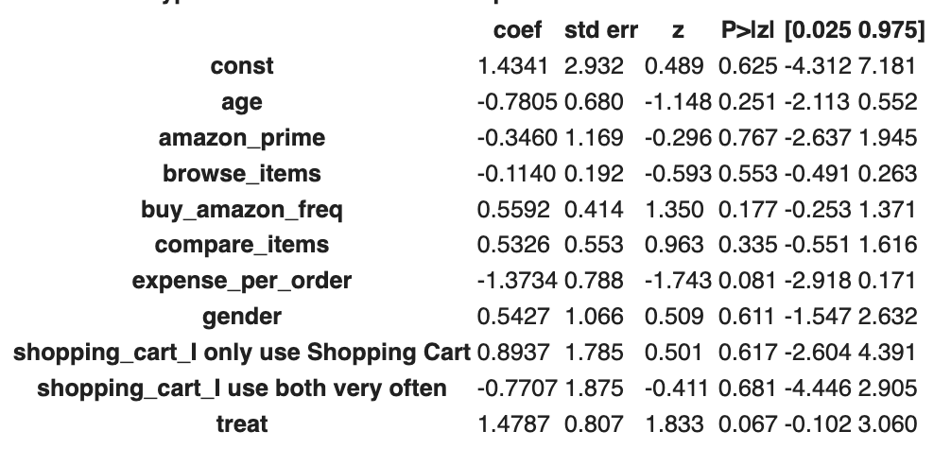
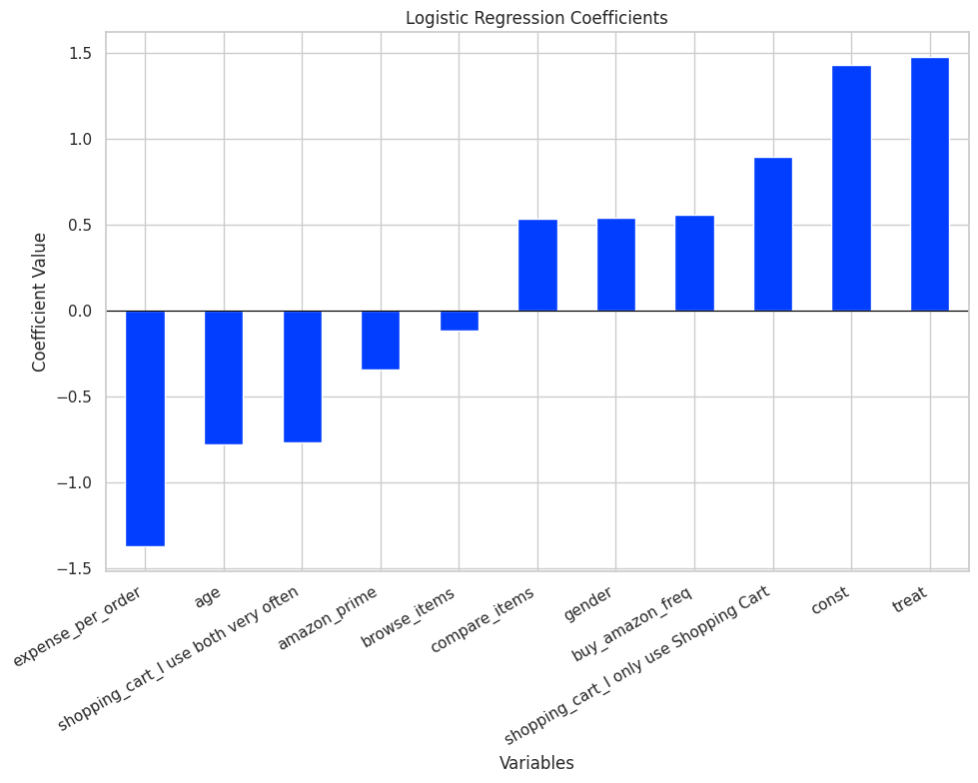
Results - Logistic Regression
The P value has improved, but still remained insignificant; let’s see if adding an interaction term help.

Slide 11
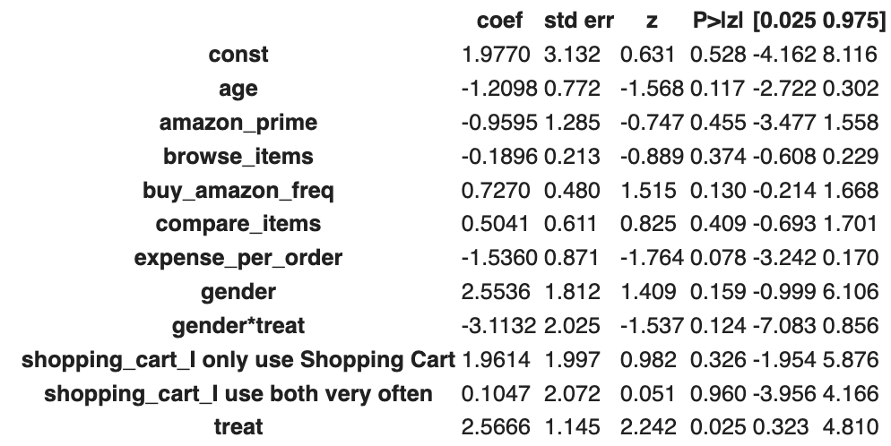
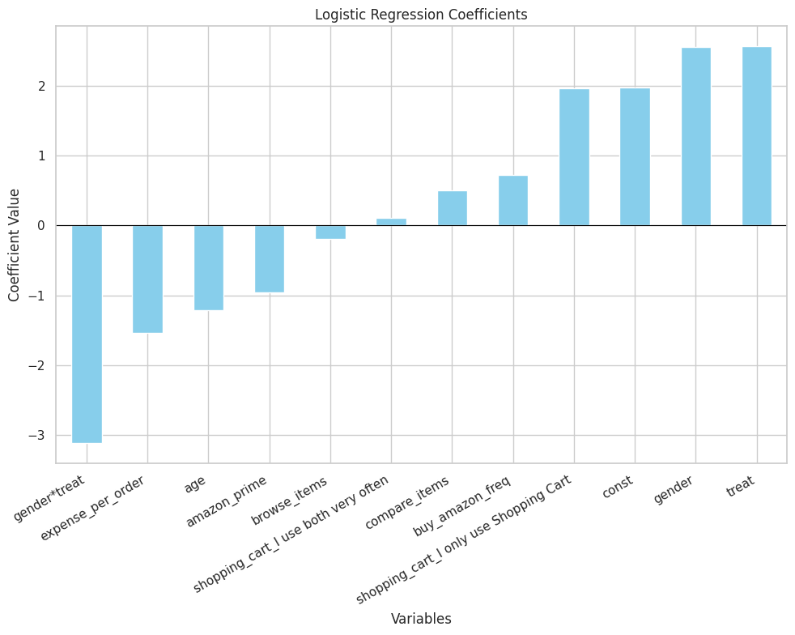
Results - Interaction Term with Logistic Regression
After adding the gender-treatment interaction term, we can observe that the p-value drops to under significance level.

Slide 12
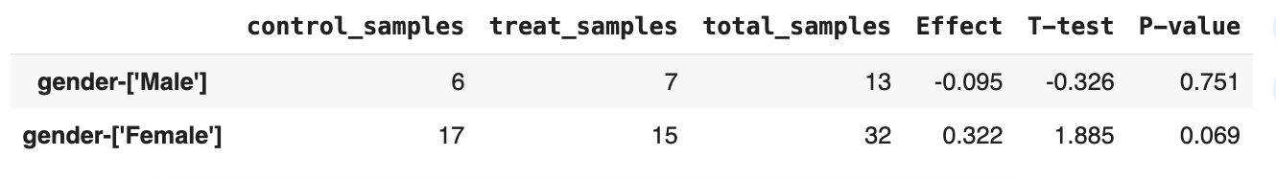
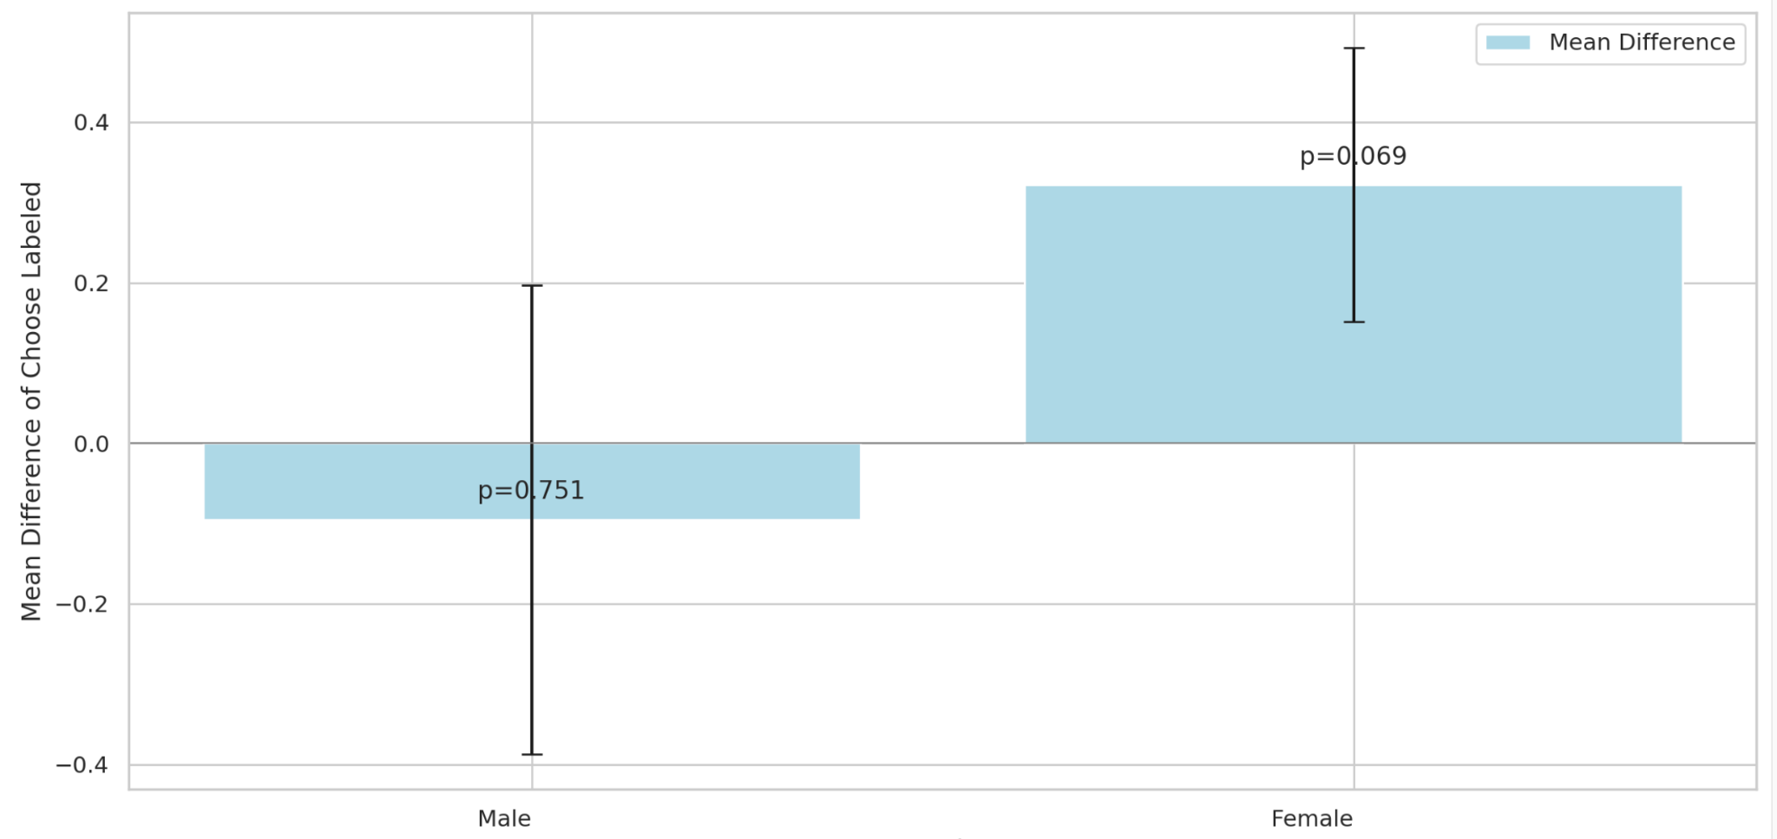
T tests with Segments-Gender
Female tend to react better with our treatment than male

Slide 13
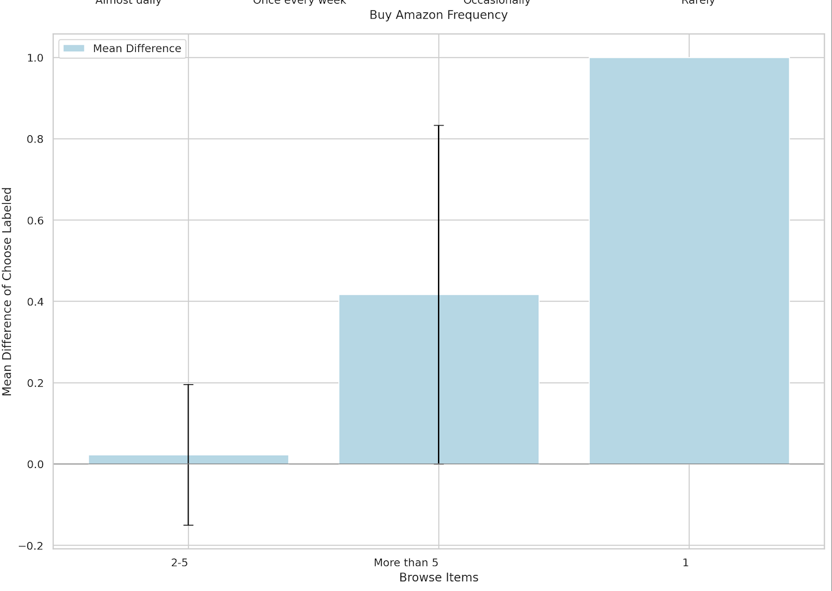
T tests with Segments- #Browse items
Female tend to react better with our treatment than male
People don’t like to browse many items tend to react better with our treatment

Slide 14
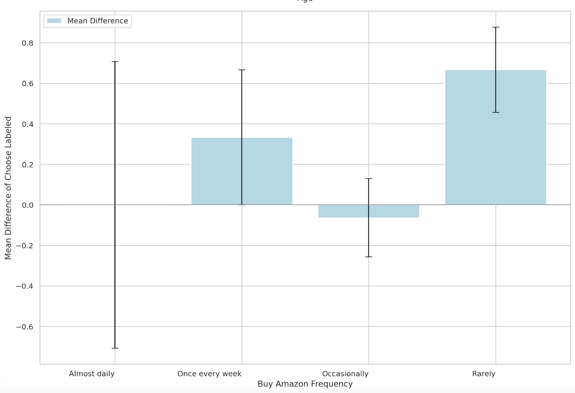
T tests with Segments- Use amazon Freq
People rarely use amazon tend to react better with our treatment

Slide 15
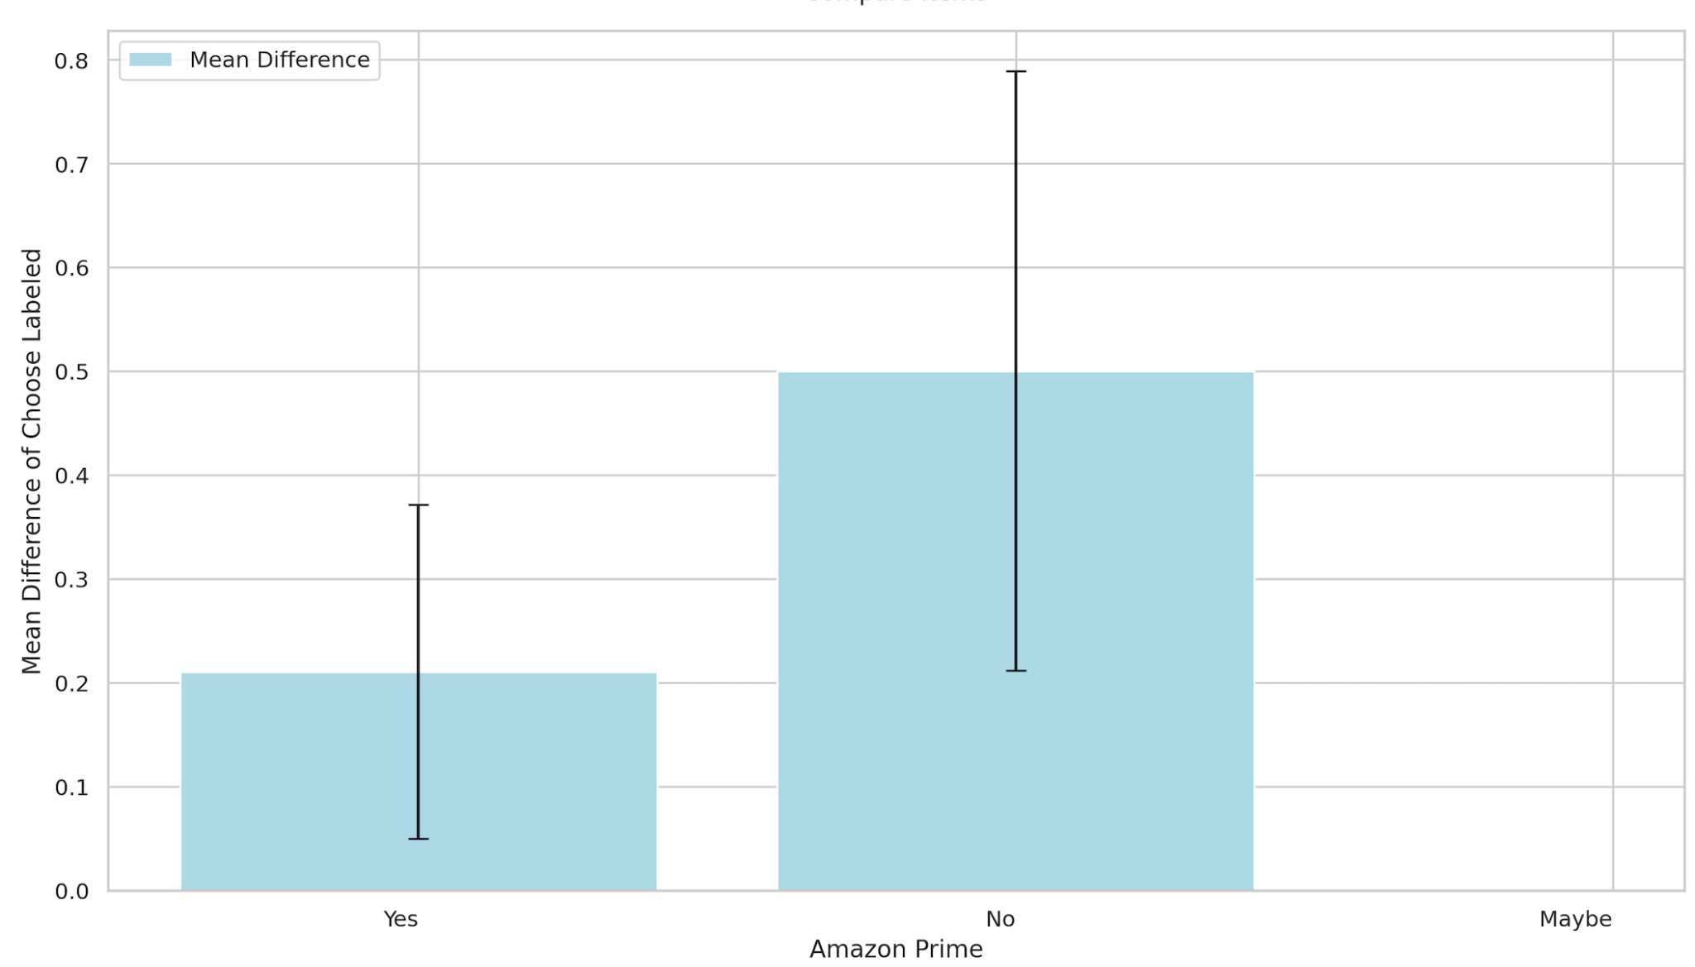
T tests with Segments- Amazon Prime
People don’t have amazon prime tend to react better with our treatment

Slide 16
Evaluation - Sample size calculation
Desired Increase
20%
Observed CTR
26/43 =0 .6
16 * (0.6)*(1-0.6)/(0.12)**2
=261.5
Variance
0.6*(1-0.6)
Sensitivity
0.72-0.6

Slide 17
Results Interpretation
Model without interaction term: treatment has a p-value of 0.067 (> 0.05).
While there may be an association between the treatment and the outcome (choosing labeled items), the evidence is not strong enough to assert this with high confidence
Model with interaction term (gender): treatment has a p-value of 0.025 (< 0.05).
When controlling for the interaction between gender and treatment, the treatment has a significant effect on the outcome

Slide 18
Some Other Interesting Findings
The treatment appears to have a more positive effect on female, with a near-significant p-value, suggesting a possible trend that females might be more influenced by the treatment than males. However, the difference is not statistically significant.
Participants who browse fewer items (1 item) show a higher effect size compared to those who browse more items. However, the difference is not statistically significant.
Users who rarely buy on Amazon show the largest effect size suggesting they may be more influenced by the treatment. However, the difference is not statistically significant.
Non-prime members showed a marginally higher effect from the treatment compared to the prime members, the difference is not statistically significant.

Slide 19
Conclusion
The data does not provide enough evidence to reject the null hypothesis in favor of the alternative across the entire sample.
While there are indications that certain segments of the population may be positively influenced by the treatment of grouping and prioritizing labeled products, these effects do not consistently reach statistical significance.
Further research with large sample sizes or different methodologies may be necessary to explore these trends more deeply.

